Slide 1
Design Decisions & Code Generation
Design Decisions in Computing, Compilers: Code Generation, Two-Tier Compilation

Slide 2
Lecture Outline
Design Decisions in Computing
  Understanding Design and Its Importance
  Design Decisions in Computing
Compilers: Code Generation
  Generating Target Code from an AST
Two-Tier Compilation
  Intermediate Programs and The Java Virtual Machine (JVM)

Slide 3
What is Design?
The way something works, including how someone uses it
  Almost always includes some element of interaction
Design could have different definitions, goals, and interpretations in different contexts
  It’s also not always about the end-user of a product
  For example, you might design a codebase that’s easier to maintain
Everything we create has design, but there is a range to how intentional the design of something is
  Could be completely forgotten
  Could be focused on throughout the creation of something

Slide 4
Why Talk About Design?
If design is “the way something works, including how someone uses it,” then it dictates the interactions between us and the designs we interact with
Those interactions have a range of consequences
  Positive: When you go to a website, and you are easily able to find all the information you need
  Unideal: If a person can’t easily drink from a certain cup
  Harmful: If a person can’t easily use emergency equipment

Slide 5
Why Talk About Design?
Seemingly harmless interactions can have a negative impact on certain people, especially if repeated
  E.g., Unable to use any door you see will make you feel unwelcome
How can we design to create more positive reactions for more people while mitigating negative interactions?
  Tough question in a world with so many diverse people
What accountability should there be for more harmful interactions caused by the design of something?
  A significant question with a muddy web of answers

Slide 6
An Aside: Bias
Biases are the beliefs we have, often formed by our experiences
  Can be explicit: We consciously have a belief about something and it may intentionally impact us
  Can be implicit: Unconscious or impact us unintentionally
We all have bias, and it is not inherently “good” or “bad”
  Both potentially beneficial and potentially harmful consequences
Eliminating bias is not a realistic goal
  Attempting to mitigate negative consequences that come from bias is more realistic

Slide 7
Designer’s Bias
People often think of the “typical user” as someone who is similar to them or those they are close to
  An example of the influence of their biases
Even if we try to think beyond what is familiar to us, it is unlikely we will remove bias from the design process
  Opinions about what something “should” do are inherently biased
Ideally, we would develop processes that mitigate the negative effects of biases as much as possible
  Recall biases can be both known (explicit) and unknown (implicit)

Slide 8
Bias and Design
Following slides include some ideas and frameworks people have come up with related to bias and design
Not meant to be the most important ideas
  Think of it more as a few reference points that you can learn more about beyond this lecture
  Discussions about bias and design are very nuanced and constantly evolving
None completely solve these issues, but they can be used to think about them and build better practices

Slide 9
Universal Design
Big idea: Design things that can be used by as many people as easily as possible
Designing things that work well for a wide range of people includes those who might usually be excluded
  For example: Video captioning
The process of “including everyone” leads us to better design

Slide 10
Inclusive Design
Including as diverse a range of perspectives when designing something as possible
  Similar to universal design, but you may offer different solutions for different types of people (rather than one solution for all)
  “Including” a diverse perspective does not just mean having a diverse team of people
  It means valuing a diversity of opinions and experiences
If we prioritize diverse perspectives, especially those that have been typically excluded, it will lead to things that benefit more people

Slide 11
Affordance Theory
Way of thinking about things around us
Things provide different affordances to people
  A way of defining what the capabilities of something are
Can group these affordances into different categories:
  What affordances does someone think/perceive something provides them?
  What affordances does something actually provide someone?

Slide 12
Affordance Types
Four types of affordances (in reality, it’s more of a spectrum)
  Perceptible affordance: something does what someone thinks it can
  Hidden affordance: something does what someone thinks it can’t
  False affordance: something doesn’t do what someone thinks it can
  Correct rejection: something doesn’t do what someone thinks it can’t

Slide 13
Design Principles in Practice
In groups, discuss the following questions:
  Observations of design in the real world
  Experiences you have had with technology that has privileged or discriminated against you
  How might you design these technologies differently to be more inclusive?

Slide 14
Design in Computing
Design discussions are relevant to computing
  Many were developed with design in mind
Technology can be biased
  Design is part of almost everything in computing
  Our biases influence the design of things
A lack of diverse perspectives can lead to many harmful designs

Slide 15
Design in Computing: Accessibility
There is a large community in CSE focused on making technology more accessible for people
  E.g., making web pages easily navigable for people who are blind
  E.g., expanding internet access to remote populations
Connection: Elements of both universal design and inclusive design
  Universal design: Designing products that work for as many people as possible
  Inclusive design: Including more perspectives in the design process, and potentially developing specific solutions aimed at including different groups of people

Slide 16
Design in Computing: Algorithmic Bias
Research related to bias in AI/ML algorithms
  E.g., Facial recognition technology not working as well on people of color (trained on primarily white datasets)
  E.g., Racial bias in crime prediction algorithms (reflects the bias of our criminal justice system)
These results biases reflect biased design decisions throughout development
  Picking datasets biased towards certain communities
  Testing applications in biased environments
  Bias in what is prioritized within an algorithm

Slide 17
Moving Towards Inclusive Design
Design is often categorized as being separate from other parts of the development process
  In reality, happens in almost every stage of developing something
You can voice feedback and concerns in design
  You are ultimately contributing to the design of it
  What conversations already occur, then ask how we can do better
Different vision of how to approach building technology
  Slogan offered by Animikii: “Move slow and empower people”

Slide 18
Next Steps in Design
Brief overview of design that only scratches the surface
Entire fields and majors related to design and computing
  Human Computer Interaction (HCI)
  User Experience (UX/UI)
  Human Centered Design and Engineering (HCDE, major at UW)
Related courses:
  CSE 340: Interactive computing
  CSE 440: Introduction to HCI
  SOC 225: Data and society
  HCDE department has some neat courses on this topic too!

Slide 19
Lecture Outline
Design Decisions in Computing
  Understanding Design and Its Importance
  Design Decisions in Computing
Compilers: Code Generation
  Generating Target Code from an AST
Two-Tier Compilation
  Intermediate Programs and The Java Virtual Machine (JVM)

Slide 20
Software
Overview
SOFTWARE
Java
Python
C/C++
Jack
High-Level Language
Compiler
Java Byte Code
Jack VM Code
Intermediate Language(s)
Compiler
(Project 8)
Compiler
(VM Translator)
x86, x86-64
ARM
RISC-V
HACK
Windows
Mac
Unix/Linux
Android
Hack OS
Assembly Language
Operating System
Assembler
Machine Code

Slide 21
The Compiler: Implementation
public int fact(int n) {
if (n == 0) {
return 1;
} else {
return n * fact(n - 1);
}
}
High-Level Language
(fact)
@R0
M=M+1
@R1
D=A
@ifbranch
D;JEQ
Assembly Language
Scanner
Parser
Type Checker
Optimizer
Code Generator
Break string into discrete tokens:
etc.
Arrange tokens into syntax tree:
Verify the syntax tree is semantically correct
Rearrange the code to be more efficient
Convert the syntax tree to the target language
IF
(
ID(n)
+
==
NUM(0)
x
10

Slide 22
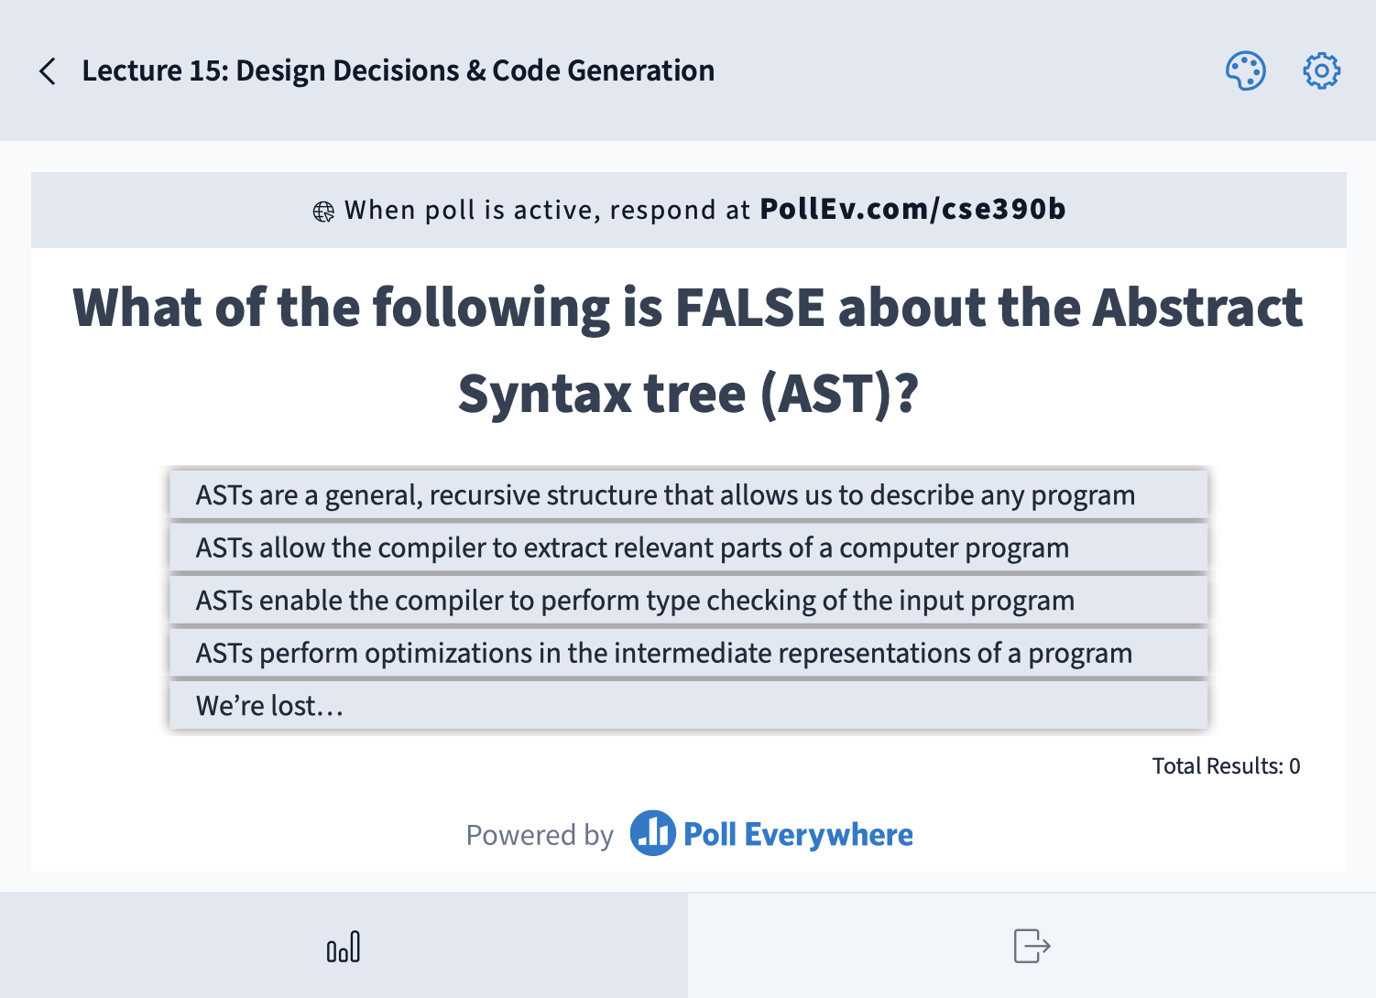
Which gates will we need to implement a Bit? Select all that apply.
Mux
Xor
And
DFF
We’re lost…
load
Bit
out
in
if load(t-1) out(t) = in(t-1)
else out(t) = out(t-1)

Slide 23
Code Generation: The Task
Convert the AST into target language code that produces the same result
Project 8 goal: Produce reliable, not efficient, compiler
The tricky bit: Do it automatically for all possible arrangements of code
  To stay sane, we’ll break the task down: Generate code for each node type in the AST
Abstract Syntax Tree
PLUS
@5
D=A
@3
D=D+A
Hack Assembly
left
right
NUM(5)
NUM(3)

Slide 24
Compile Time vs. Run Time
Compile Time
Run Time
let x = 5 + 3;
Jack
PLUS
@5
D=A
@3
D=D+A
Hack Assembly
left
right
Behavior
NUM(5)
NUM(3)
Compiler (a Java program) is running
    Generates Hack instructions that will be run later
Know types of variables, but NOT the values of variables or which code path is taken
Output (a Hack program) is running on the Hack computer
Know value of variables, which code path is taken

Slide 25
Code Generation: Example
How would you, a brilliant human, translate this abstract syntax tree into Hack Assembly?
Abstract Syntax Tree
PLUS
left
right
NUM(5)
NUM(3)

Slide 26
Code Generation: Example
Here’s how you, a brilliant human, would likely translate this syntax tree into Hack:
@5
D=A
@3
D=D+A
Hack Assembly
Human
(genius)
Abstract Syntax Tree
PLUS
left
right
NUM(5)
NUM(3)

Slide 27
Code Generation: Example
Here’s how you, a brilliant human, would likely translate this syntax tree into Hack:
@5
D=A
@3
D=D+A
Hack Assembly
Human
(genius)
Abstract Syntax Tree
@5
D=A
@R0
M=D
// save R0 somehow
@3
D=A
@R0
M=D
@R0
D=M
// restore R0
@R0
MD=D+M
Hack Assembly
PLUS
left
right
NUM(5)
NUM(3)
Computer
(trying its best)

Slide 28
Code Generation: Example
Why? Modularity: We can fit any expression in that slot, as long as its result ends up in R0!
@5
D=A
@R0
M=D
// save R0 somehow
@3
D=A
@R0
M=D
@R0
D=M
// restore R0
@R0
MD=D+M
NUM
Abstract Syntax Tree
PLUS
left
right
Computer
(actually, quite clever!)
NUM(5)
NUM(3)
PLUS
NUM(3)

Slide 29

Code Generation: Example
Why? Modularity: We can fit any expression in that slot, as long as its result ends up in R0!
  Even another !
PLUS
@5
D=A
@R0
M=D
// save R0 somehow
@3
D=A
@R0
M=D
@R0
D=M
// restore R0
@R0
MD=D+M
NUM
Abstract Syntax Tree
PLUS
left
right
NUM(5)
PLUS
PLUS
left
right
NUM(3)
NUM(1)
NUM(2)

Slide 30
Code Generation: Example
Now, we need to save R0 somehow
@5
D=A
@R0
M=D
// save R0 somehow
@3
D=A
@R0
M=D
@R0
D=M
// restore R0
@R0
MD=D+M
NUM
Abstract Syntax Tree
PLUS
left
right
NUM(5)
NUM(3)
PLUS
NUM(3)

Slide 31
Code Generation: Example
Now, we need to save R0 somehow
  What if we save it in a temporary register? Let’s pick R2
@5
D=A
@R0
M=D
@R0
D=M
@R2
M=D
@3
D=A
@R0
M=D
@R0
D=M
// restore (reverse)
@R0
MD=D+M
NUM
Abstract Syntax Tree
PLUS
left
right
NUM(5)
NUM(3)
PLUS
NUM(3)

Slide 32
Code Generation: Example
Now, we need to save R0 somehow
  What if we save it in a temporary register? Let’s pick R2
Why won’t this always work?
@5
D=A
@R0
M=D
@R0
D=M
@R2
M=D
@3
D=A
@R0
M=D
@R0
D=M
// restore (reverse)
@R0
MD=D+M
NUM
Abstract Syntax Tree
PLUS
left
right
NUM(5)
NUM(3)
PLUS
NUM(3)

Slide 33
Code Generation: Example
It’s those pesky nested expressions! The outer PLUS saves a value in R2, but the inner PLUS overwrites that value during its computation
@5
D=A
@R0
M=D
// save R0 in R2
@1
D=A
...
// save R0 in R2
...
@R0
MD=D+M
@R0
D=M
// restore R0 from R2 (!)
@R0
MD=D+M
NUM
Abstract Syntax Tree
PLUS
left
right
PLUS
NUM(5)
PLUS
left
right
PLUS
NUM(1)
NUM(2)

Slide 34
Code Generation: Example
Abstract Syntax Tree
PLUS
left
right
NUM(5)
PLUS
left
right
Solution: Store “saved” values in a stack
  Not quite the same as “The Stack” or function
  call stack frames (but used for a
  similar reason)
We’ll keep a stack starting at
memory address 1024
  R1 is our stack pointer: always stores
  address of last used stack position
  No built-in Hack push: manually copy
  to memory and increment R1
NUM(1)
NUM(2)
@5
D=A
@R0
M=D
// push R0 to slot 0
@1
...
// push R0 to slot 1
...
// pop R0 from slot 1
@R0
MD=D+M
@R0
D=M
// pop R0 from slot 0
@R0
MD=D+M
NUM
PLUS
PLUS
R1
1024
1025
1026
1027
1025
(R0)
(R0)

Slide 35
Code Generation: Example
@5
D=A
@R0
M=D
// Push R0 to addr 1024
@1
D=A
@R0
M=D
// Push R0 to addr 1025
@2
D=A
@R0
M=D
@R0
D=M
// Pop R0 from addr 1025
@R0
MD=D+M
@R0
D=M
// Pop R0 from addr 1024
@R0
MD=D+M
NUM
Let’s trace through an example of using the stack in code generation for the following AST:
Abstract Syntax Tree
PLUS
PLUS
PLUS
left
right
NUM(5)
PLUS
left
right
NUM(1)
NUM(2)
R1
1024
1025
1026
1027

Slide 36
Code Generation: Example
What about variables?
Just like Assembler: Generate symbol table with mapping from variable names to spots in memory
  Arrays get more (contiguous) spots
  screen and keyboard are built-in array variables, allowing I/O
arr
256
var int arr[5];
var int bar, star;
let bar = star;
Jack
@261
D=M
@262
M=D
Hack Assembly
bar
261
star
262
screen
16384

Slide 37
Code Generation: Takeaways
Code Generation task: Writing several small snippets of Hack assembly
  But need to be very generalizable
  Whenever a PLUS expression is encountered, should generate almost the same code
Conventions make the task much easier
  For example, after any expression code runs, result should always be stored in R0
  Then parent code can depend on it

Slide 38
Lecture Outline
Design Decisions in Computing
  Understanding Design and Its Importance
  Design Decisions in Computing
Compilers: Code Generation
  Generating Target Code from an AST
Two-Tier Compilation
  Intermediate Programs and The Java Virtual Machine (JVM)

Slide 39
Software
Overview
SOFTWARE
Java
Python
C/C++
Jack
High-Level Language
Compiler
Java Byte Code
Jack VM Code
Intermediate Language(s)
Compiler
Project 8
Compiler
(VM Translator)
x86, x86-64
ARM
RISC-V
HACK
Windows
Mac
Unix/Linux
Android
Hack OS
Assembly Language
Operating System
Assembler
Machine Code
“Real-World” Examples
Our Computer
KEY:

Slide 40




Compiling Code: Single Tier
High-Level Program
Compiler for D
Compiler for A
Compiler for C
Compiler for B
Device A
Device B
Device C
Device D

Slide 41
Compiling Code: Two Tier
High-Level Program
Compiler for VM
Intermediate Program
VM Translator
for A
VM Translator
for D
VM Translator
for B
VM Translator
for C
Device A
Device B
Device C
Device D

Slide 42
The Java Virtual Machine (JVM)
Java Code
Java Compiler
JVM
JVM Runtime for A
JVM Runtime
for D
JVM Runtime
for B
JVM Runtime
for C
Device A
Device B
Device C
Device D

Slide 43
Post-Lecture 15 Reminders
Project Reminders
  Project 7, Part I: Midterm Corrections due this Thursday (5/18) at 11:59pm (no late days may be used)
  Project 7, Part II: Professor Meeting Report due next Thursday (5/25) at 11:59pm
Preston has office hours after class in CSE2 152
  Feel free to post your questions on the Ed board as well

